Slide 1
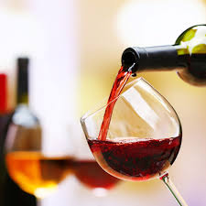
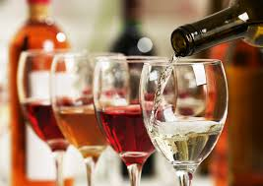


Wine Quality Prediction – Machine Learning
Ramlal Arya
https://github.com/ramlalarya
www.linkedin.com/in/ramlal-arya-8b90a069

Slide 2
Objective
We have two separate data sets Red wine dataset and White wine dataset.
We have to combine both datasets into one dataset with wine type parameter as red and white.
Further we have categorized wine quality into three classes “Low”, “Medium” and “High” based on numeric value of quality field.
Performed Univariate and Multivariate analysis.
Create some visualizations to find how residual sugar, density and alcohol affect the wine quality.
Perform various Machine Learning algorithms for predicting of wine type and wine quality.

Slide 3
About the Data
The datasets are collected from UCI Machine Learning Repository, we have two datasets one Red wine dataset and another is White wine dataset.
Data Source:
http://archive.ics.uci.edu/ml/datasets/wine+quality
Data Volume:
Here we have two datasets red wine and white wine, both datasets contain 12 attributes.
Attributes
Input Variables
Output Variables
fixed acidity
volatile acidity
citric acid
residual sugar
Chlorides
free sulfur dioxide
total sulfur dioxide
Density
pH
sulphates
alcohol
quality

Slide 4
Data Analysis
Data Preparation
Combined both datasets in one dataset.
Create new column as wine type with value as “red” and “white”.
Create one more new column as wine quality for classifying wine
- low (quality <= 5)
- medium (5 < quality <= 7)
- high (quality > 7)

Slide 5
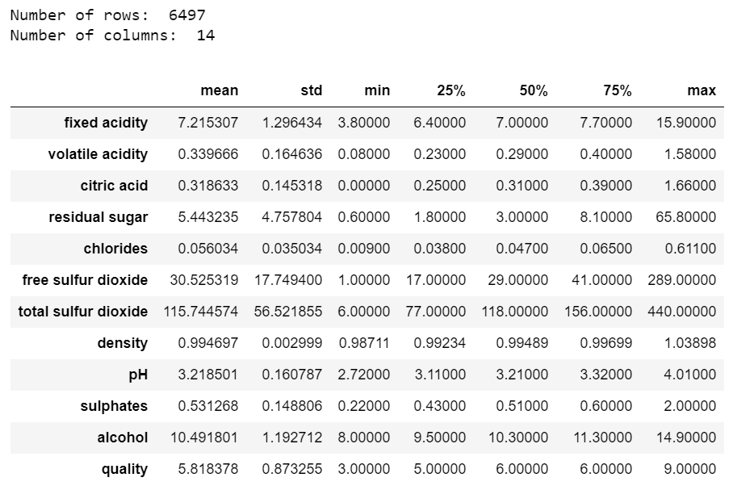
Data Description
Statistics of numerical columns in the dataset

Slide 6
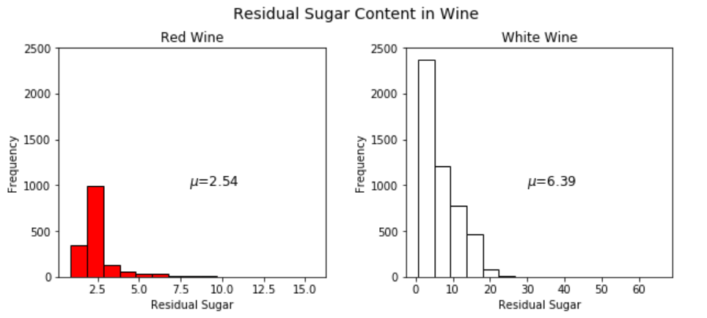
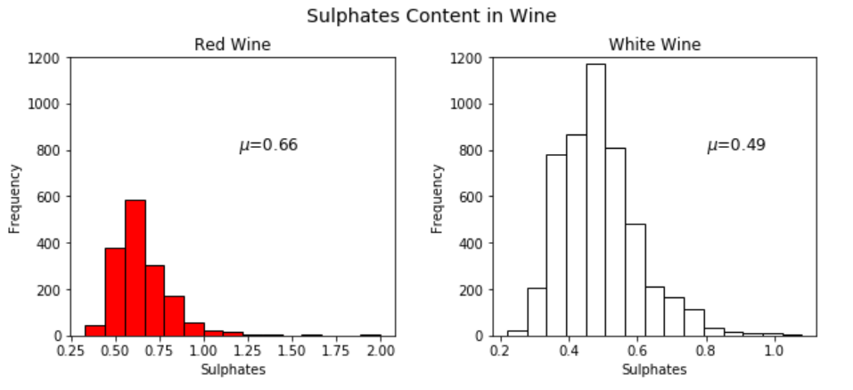
Univariate Analysis
Conclusion
residual sugar content in white wine samples seems to be more as compared to red wine samples
Conclusion
sulphate content in white wine seems to be higher as compare to red wine.

Slide 7
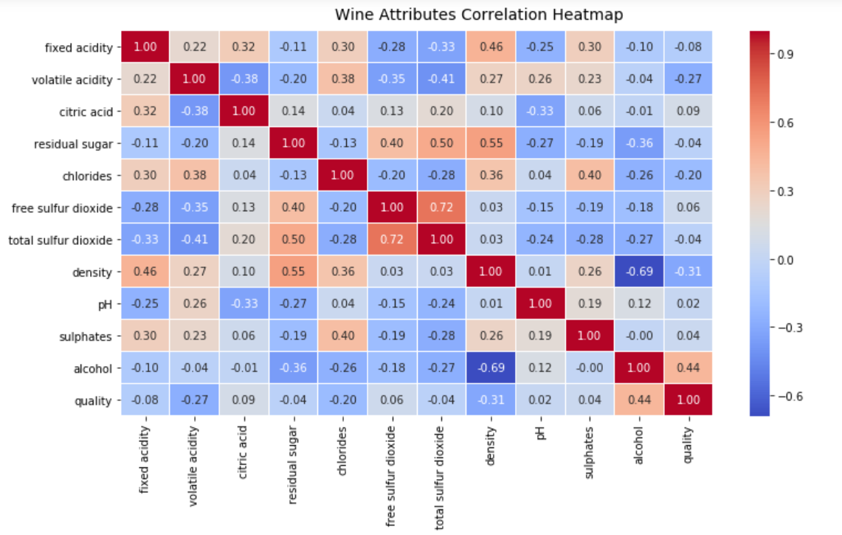
Multivariate Analysis
Conclusion
density has strong negative correlation with alcohol.
wine quality has positive correlation with alcohol.
total sulfur dioxide has strong positive correlation with free sulfur dioxide.

Slide 8
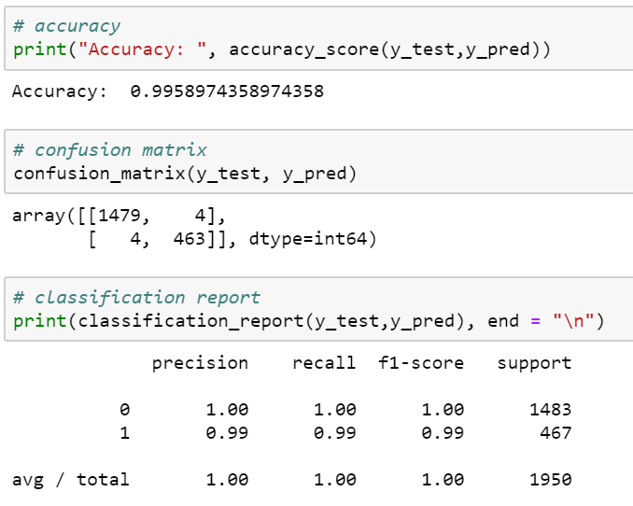
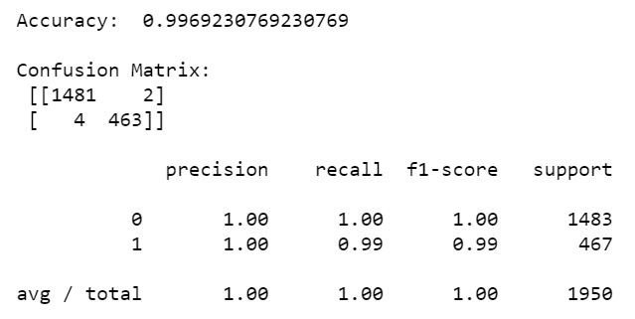
Predictive Analysis
Prediction – Wine Type
Logistic Regression
Build a classification model by using Logistic Regression to predict the type of wine “red” or “white”.
Random Forest
Build a classification model by using Random Forest Classification to predict the type of wine “red” or “white”.

Slide 9
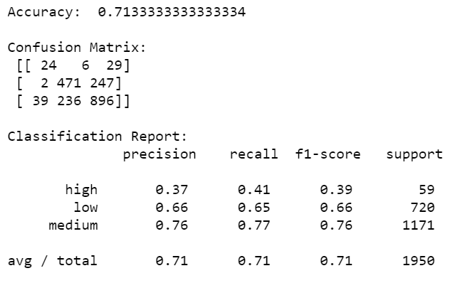
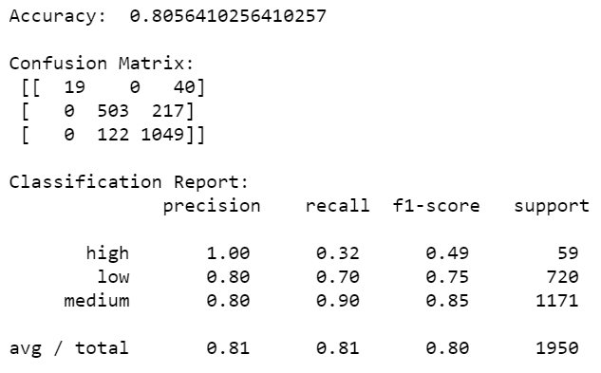
Predictive Analysis
Prediction – Wine Quality
Decision Tree
Build a classification model by using Decision Tree to predict the quality of wine as “low”, “medium” or “high”.
Random Forest
Build a classification model by using Random Forest to predict the quality of wine as “low”, “medium” or “high”.

Slide 10
Predictive Analysis
Prediction – Wine Type
We saw that accuracies in both models are comparable, so any model can be used, Logistic Regression is preferred here because it is simple to implement.
Prediction – Wine Quality
We obtained higher accuracy in the model built by using Random Forest Classification, hence Random Forest model is much batter than the Decision Tree model.

Slide 11
Conclusion
Insights from analysis
Characteristics
- Wine type as Red or White.
- Wine quality as Low, Medium or High.
Ingredients which contribute more for wine type.
- Sulphates, chlorides, free sulfur dioxide, total sulfur
dioxide, volatile acidity.
Ingredients which contribute more for wine quality.
- Alcohol and density.

Slide 12
Thank You
Python Notebooks used for analysis on Github:
https://github.com/ramlalarya/Machine-Learning-Project

